Slide 1
Small Business Loan Predictor
By Michael Drinkard

Slide 2


The Setting
I work for the US Small Business Administration and my Job is to analyze whether or not to give out a loan to a small business
I’m tired of actually doing work and would rather browse youtube and watch shorts
I’ve heard about machine learning and neural networks and figured it’d be great if my computer could do my work for me.
I can’t let my boss know though otherwise he would replace me.

Slide 3

Objective
To create a model to predict whether a small business will default or not.

Slide 4

Data source
Dataset Obtained in Kaggle
Real Data from the U.S Small Business Loan Administration
Shape (899164,27)

Slide 5
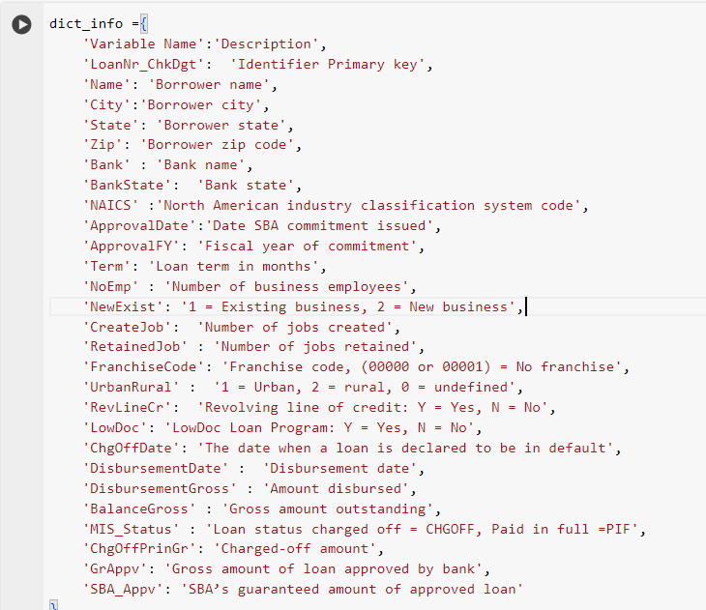
Data Cleaning
Three Step Process
Identify columns that would contribute to the model
Identify columns that would leak data to the model
Categorize the Data to be kept in a way that would make it function with the model.

Slide 6
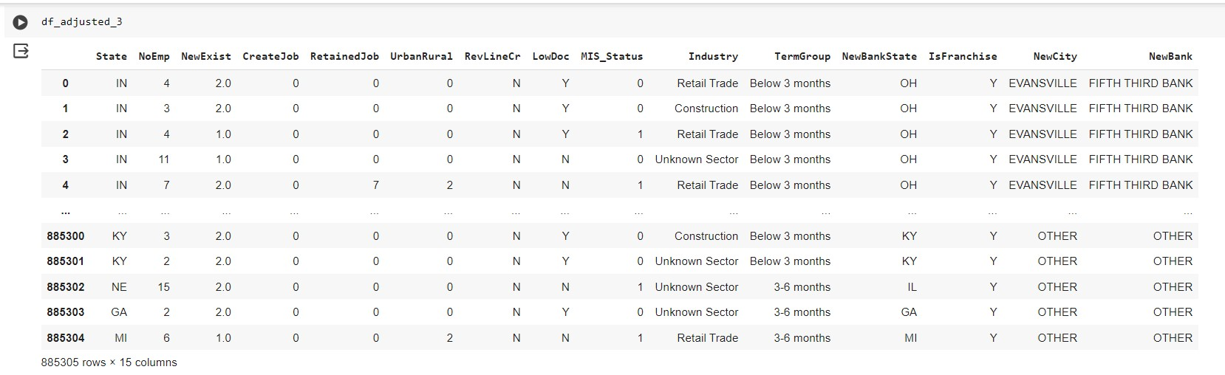
Cleaned Dataset

Slide 7
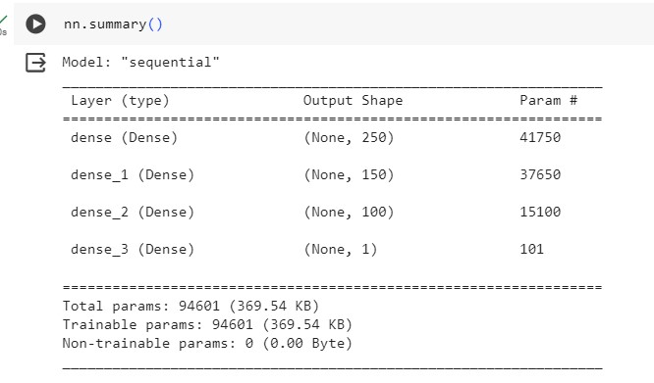
Neural Network
Categorize Object Columns using OneHotEncoder.
Initialized my Y column as my MIS_Status column and X as everything else.
Structure -> Features = 163

Slide 8

Learning/Obstacles
Too many unique values caused google colab to crash so I had to drop the ‘NewCity’ Column.
Even with the dropped column, I had to run it in batches else it would crash.

Slide 9
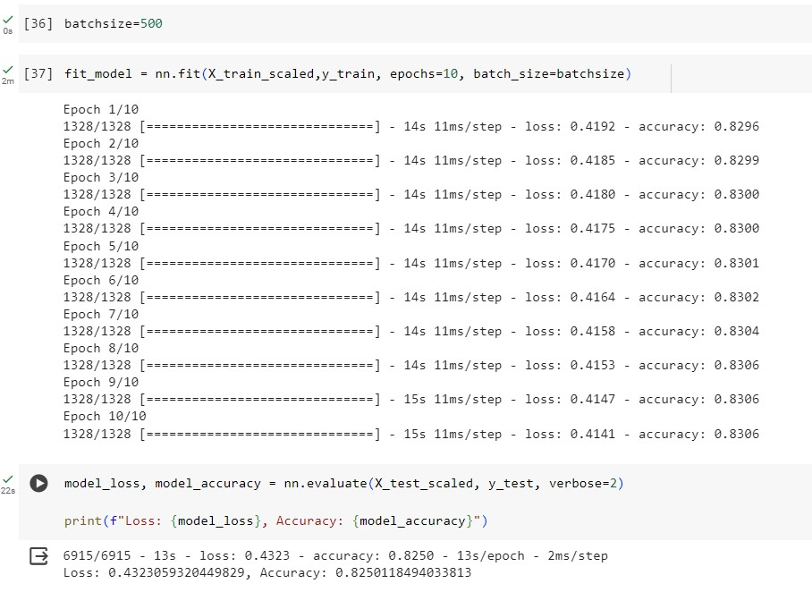
Output 1 Neural Network

Slide 10
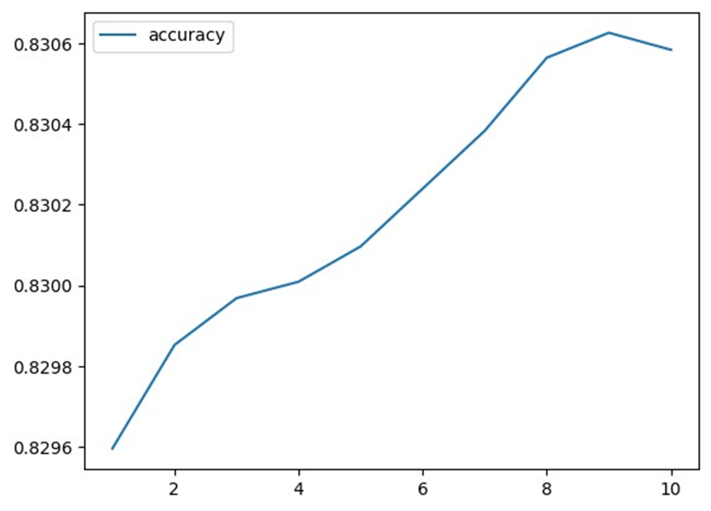
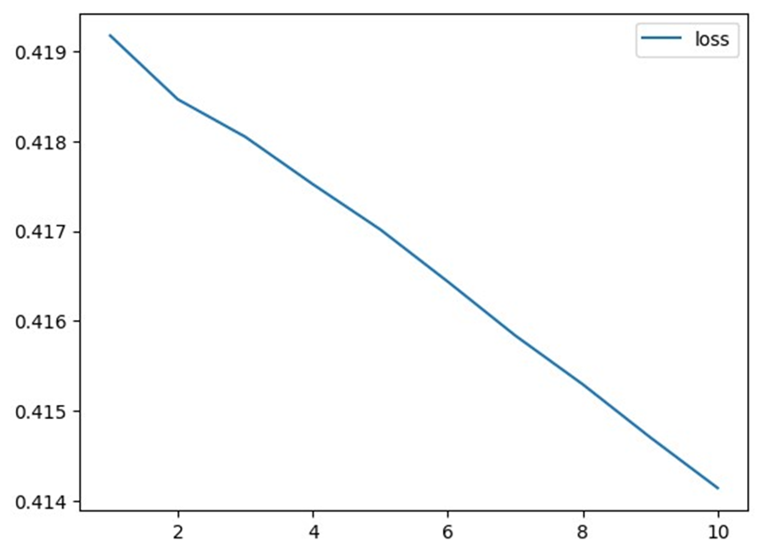
Graphs Output 1
ACCURACY
LOSS
Data was Very Linear, when it should look exponential
METRIC
EPOCHS

Slide 11
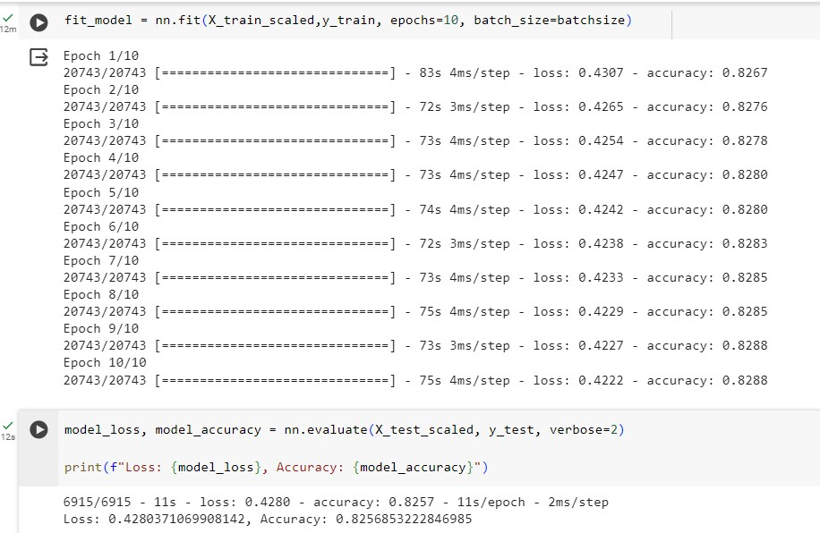
Output 2 Neural Network
Batchsize=32

Slide 12
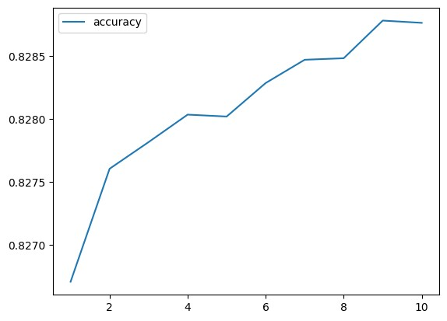
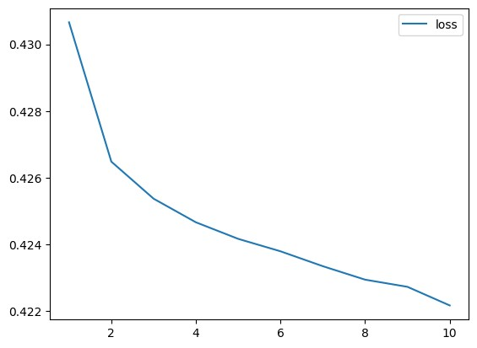
Graphs Output 2
ACCURACY
LOSS
Took a Long Time, so I decided to go with a larger batchsize
METRIC
EPOCHS

Slide 13
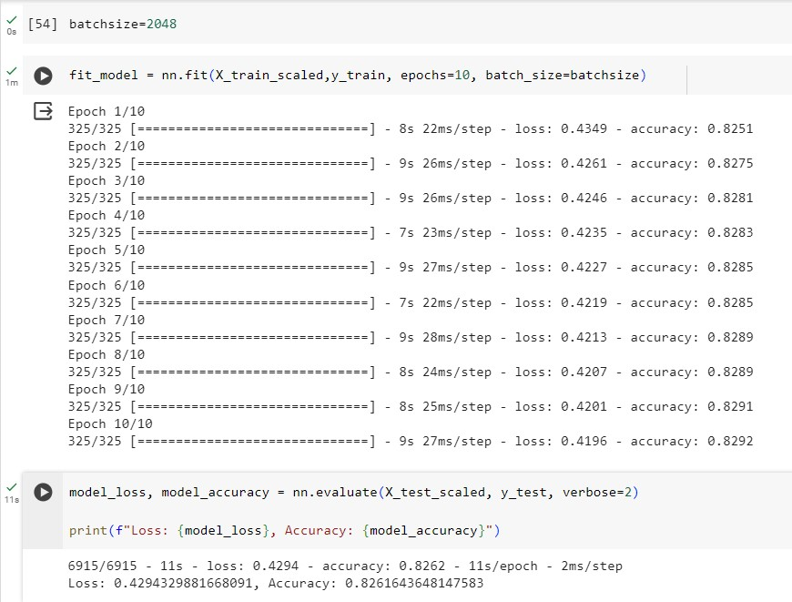
Output 3 Neural Network

Slide 14
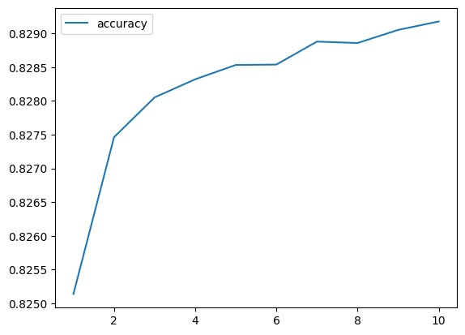
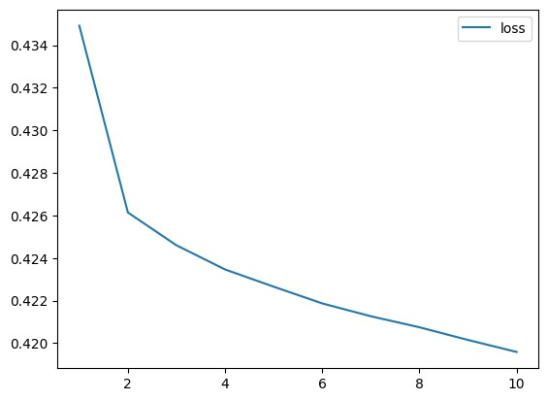
Output Graph 3
ACCURACY
LOSS
This was where I stopped
METRIC
EPOCHS

Slide 15
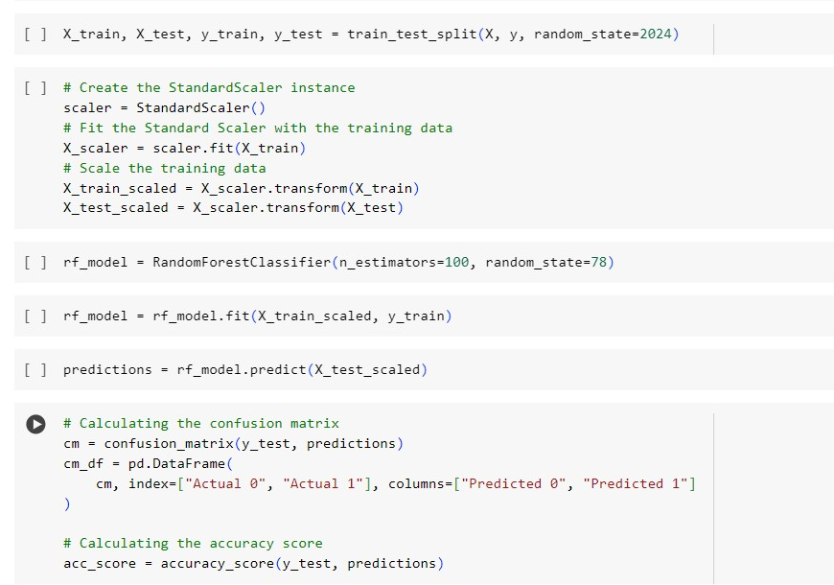

Random Forest
Parameters of my Random Forest

Slide 16
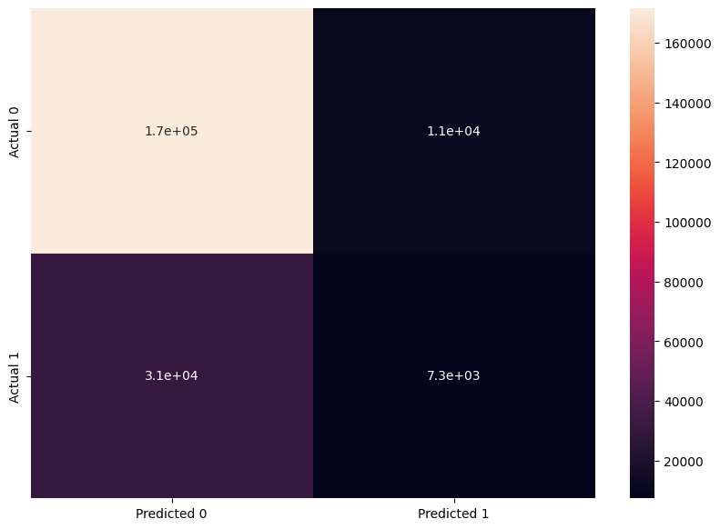
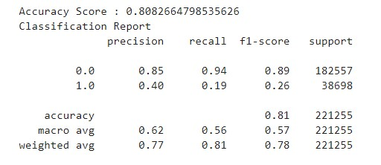
Random Forest Results
Confusion Matrix
Classification Report
0 = No Default
1 = Default

Slide 17
Contrast
Neural Networks
Able to process large datasets more efficiently
Achieve higher accuracy
More complex to set up, however, more options to customize the model.
Random Forest
Great way to process simple amount of data
Need to be careful with large datasets as it will take a long time to run.

Slide 18

Conclusion
Created a model to predict whether or not the business will default on its loan with an 82% accuracy
According to the study (Determinants of firms’ default on unsecured loans in the P2P crowdfunding market) 1 in 6 Small businesses will default on their loans which is about a 16% rate.
This tells me I should probably refine my model more before deploying it.
TLDR: MORE WORK NEEDED

Slide 19

How to Refine Model?
Go back to the Data and format it differently
Breakup the Dataset by State and keep the NewCity Column
Dropping the Other data in the bank column.

Slide 20
Thanks for Listening! Any Questions?

